Slide 1
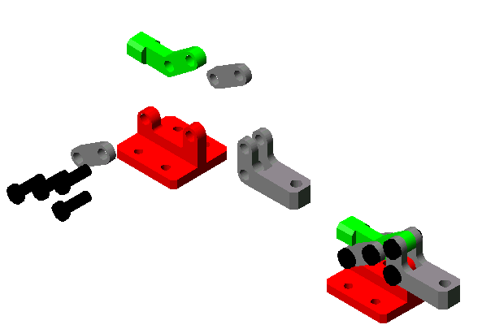

Slide 2
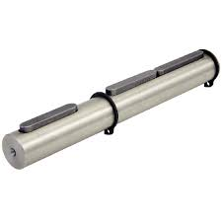
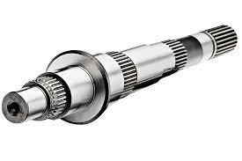
Shafts
Couplings
Gears
Flexible Power-Transmitting Elements
Threaded Fasteners
Roller Bearings
Others
A shaft is a rotating machine element, usually circular in cross section, which is used to transmit power from one part to another. The various members such as pulleys and gears are mounted on it.
Notes:
A shaft is a rotating machine element, usually circular in cross section, which is used to transmit power from one part to another, or from a machine which produces power to a machine which absorbs power. The various members such as pulleys and gears are mounted on it.
2

Slide 3
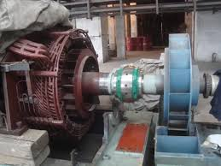
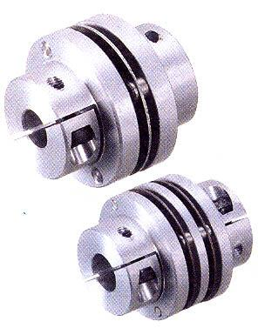
DEFINITION
TYPES
IDENTIFICATION
Couplings
Gears
Flexible Power-Transmitting Elements
Threaded Fasteners
Roller Bearings
Others
Shaft couplings are used for power and torque transmission between two rotating shafts.
Notes:
such as on motors and pumps, compressors, and generators
3

Slide 4
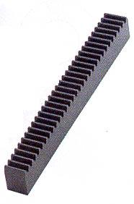
DEFINITION
TYPES
IDENTIFICATION
Couplings
Gears
Flexible Power-Transmitting Elements
Threaded Fasteners
Roller Bearings
Others
A toothed mechanism used to transmit motion either to shafts (parallel or perpendicular) or racks.

Slide 5
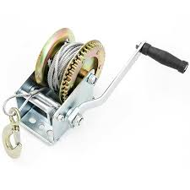

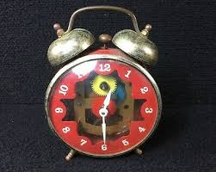
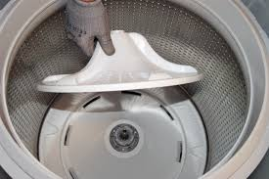
DEFINITION
TYPES
IDENTIFICATION
Couplings
Gears
Spur
Bevel
Worm
Flexible Power-Transmitting Elements
Threaded Fasteners
Roller Bearings
Others
Spur Gears are usually used for "slow speeds."
Notes:
Examples are winches(torno), wind-up clocks, and washing machines.
5

Slide 6
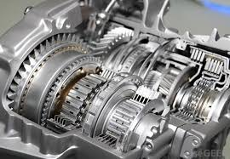

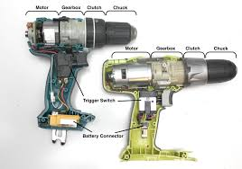
DEFINITION
TYPES
IDENTIFICATION
Couplings
Gears
Spur
Bevel
Worm
Flexible Power-Transmitting Elements
Threaded Fasteners
Roller Bearings
Others
Bevel Gears are used for objects that reach higher speeds.
Notes:
, such as certain automobiles and hand drills
6

Slide 7
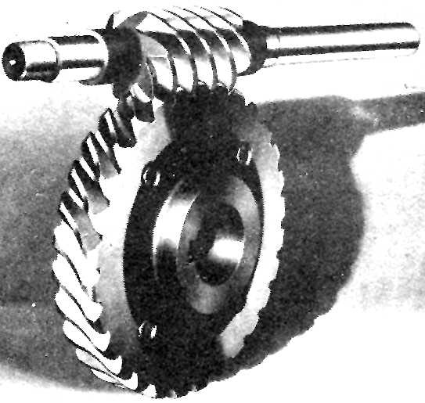
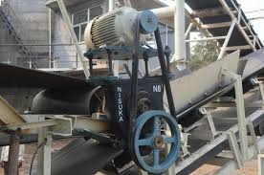
DEFINITION
TYPES
IDENTIFICATION
Couplings
Gears
Spur
Bevel
Worm
Flexible Power-Transmitting Elements
Threaded Fasteners
Roller Bearings
Others
Worm Gears are often used to lock the gears.
Notes:
in conveyor systems
7

Slide 8
DEFINITION
TYPES
IDENTIFICATION
Couplings
Gears
Flexible Power-Transmitting Elements
Threaded Fasteners
Roller Bearings
Others
Flexible drives are generally used for the transmission of power over comparatively long-distances.

Slide 9
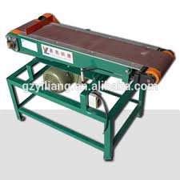
DEFINITION
TYPES
IDENTIFICATION
Couplings
Gears
Flexible Power-Transmitting Elements
Flat Belt
V-Belt
Chain
Timing Belt
Threaded Fasteners
Roller Bearings
Others
Flat belts are forgiving of misalignment; however, proper alignment improves belt life for any drive.

Slide 10
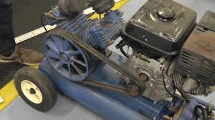
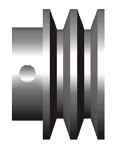
DEFINITION
TYPES
IDENTIFICATION
Couplings
Gears
Flexible Power-Transmitting Elements
Flat Belt
V-Belt
Chain
Timing Belt
Threaded Fasteners
Roller Bearings
Others
Usually made of fabric and cord and impregnated with rubber. V-Belt drive system, the thread is the V-Belt and the rollers are called as pulleys. V-Belts are friction based power or torque transmitters. The power is transmitted from one pulley to the other by means of the friction between the belt and pulley.

Slide 11
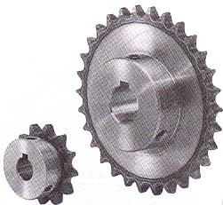
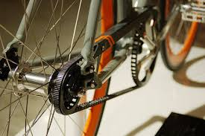
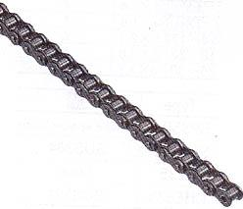
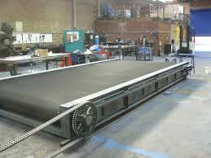
DEFINITION
TYPES
IDENTIFICATION
Couplings
Gears
Flexible Power-Transmitting Elements
Flat Belt
V-Belt
Chain
Timing Belt
Threaded Fasteners
Roller Bearings
Others
Roller chain and sprockets is a very efficient method of power transmission compared to (friction-drive) belts, with far less frictional loss.

Slide 12
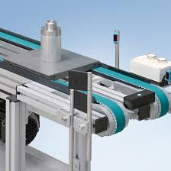
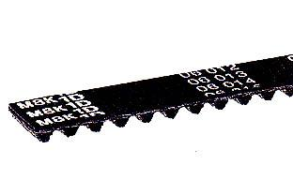
DEFINITION
TYPES
IDENTIFICATION
ADVANTAGES
Couplings
Gears
Flexible Power-Transmitting Elements
Flat Belt
V-Belt
Chain
Timing Belt
Threaded Fasteners
Roller Bearings
Others
High Mechanical Efficiency
Non-slip operation (positive drive)
Low maintenance cost
Quiet operation
High initial tension not necessary
Large capacity in small space
Can tolerate low arc of contact (minimum of 6 teeth in contact for rated power)
Minimal backlash

Slide 13
DEFINITION
TYPES
IDENTIFICATION
Couplings
Gears
Flexible Power-Transmitting Elements
Flat Belt
V-Belt
Chain
Timing Belt
Threaded Fasteners
Roller Bearings
Others
BELT WIDTH
Belts are selected according to the width of the belt
Belts must be selected from the variable standard belt widths

Slide 14
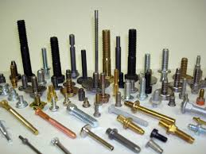
DEFINITION
TYPES
IDENTIFICATION
Couplings
Gears
Flexible Power-Transmitting Elements
Threaded Fasteners
Roller Bearings
Others
A threaded fastener is a discrete piece of hardware that has internal or external screw threads. It falls into the overall fastener family. They are usually used for the assembly of multiple parts and facilitate disassembly.
Notes:
The most common types are the screw, nut and bolt.
14

Slide 15
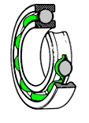
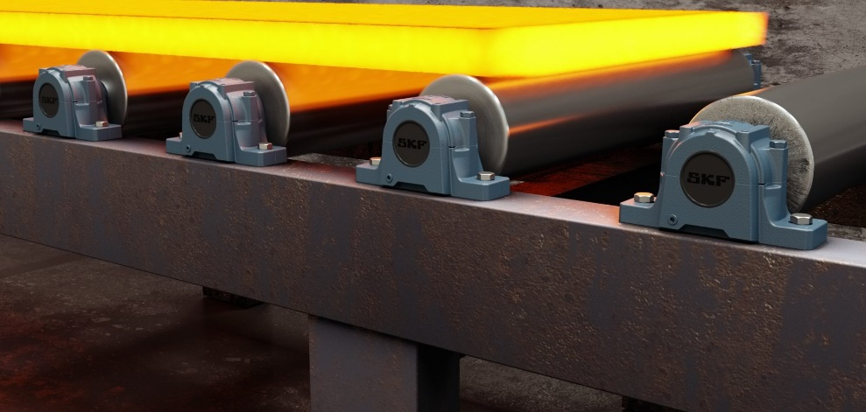
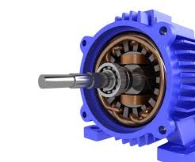
DEFINITION
TYPES
IDENTIFICATION
Couplings
Gears
Flexible Power-Transmitting Elements
Threaded Fasteners
Roller Bearings
Others
A bearing is a machine element that constrains relative motion to only the desired motion, and reduces friction between moving parts.

Slide 16
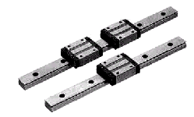
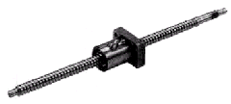
DEFINITION
TYPES
IDENTIFICATION
Couplings
Gears
Flexible Power-Transmitting Elements
Threaded Fasteners
Roller Bearings
Others
LM Rail: used as guides for sliding systems hence, also called as Slide Guides
Ball Screw: used to transfer rotational motion into linear motion

Slide 17
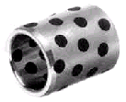
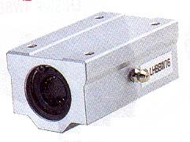

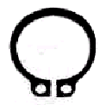
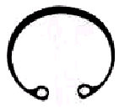
DEFINITION
TYPES
IDENTIFICATION
Couplings
Gears
Flexible Power-Transmitting Elements
Threaded Fasteners
Roller Bearings
Others
Bushing: acts similarly to bearings; 2 types available: ball bushing and oil-free bushing; ball bushings are used in splines and have ball bearings present; oil-free bushings have imbedded lubricants instead of ball bearings
Snap Ring: or Retaining Rings are usually used to prevent movement of bearings; 2 types: C-ring and E-ring; E-rings are usually used for smaller diameter shafts

Slide 18


DEFINITION
TYPES
IDENTIFICATION
Couplings
Gears
Flexible Power-Transmitting Elements
Threaded Fasteners
Roller Bearings
Others
Washer: helps in fixing of fasteners; 2 types: flat washer and spring washer; flat washers are used in slots while spring washers are used in environments where vibration is present
O-ring: used to prevent leakage

Slide 19
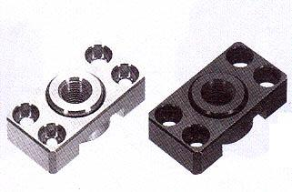
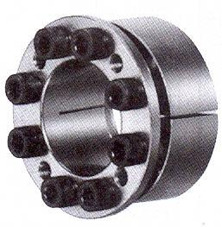
DEFINITION
TYPES
IDENTIFICATION
Couplings
Gears
Flexible Power-Transmitting Elements
Threaded Fasteners
Roller Bearings
Others
Floating Joint: usually used at the ends of cylinder rods to compensate for minor misalignment (eccentricity, deflection angle… etc.)
Power Lock: used as a lock for shafts by method of gripping

Slide 20
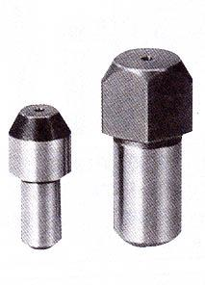
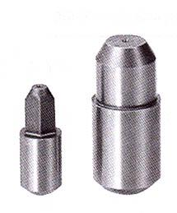

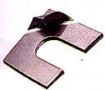
DEFINITION
TYPES
IDENTIFICATION
Couplings
Gears
Flexible Power-Transmitting Elements
Threaded Fasteners
Roller Bearings
Others
Locating Pin: for precise positioning of critical parts; prevents unnecessary movement; made of materials with high hardness
Shim: used mainly as precise spacer, to take care of small adjustments necessary

Slide 21
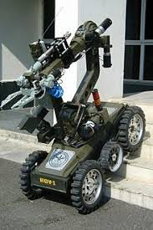
Thank You!

